Slide 1
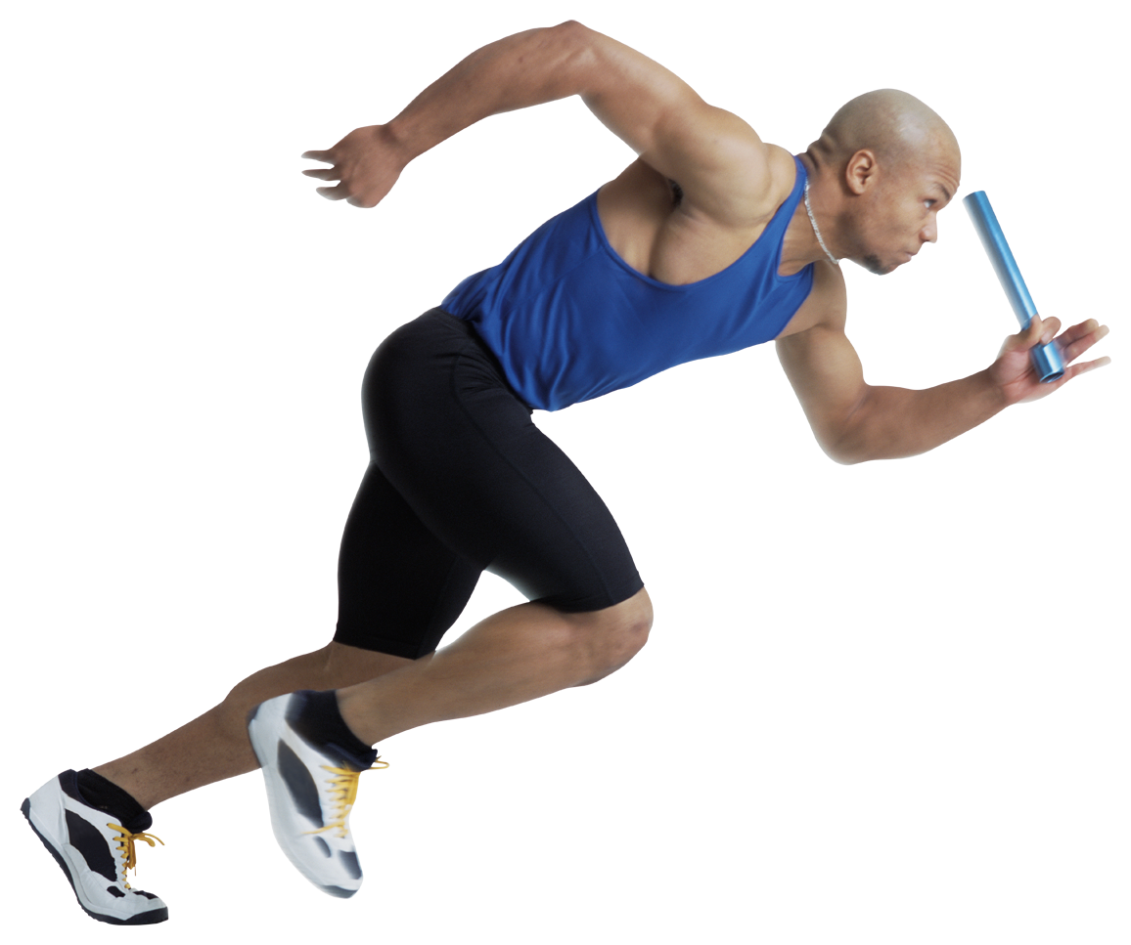
Ideal body weight
BMI
Body Types

Slide 2
Ideal body weight
A weight that is believed to be maximally healthful for a person, based chiefly on height but modified by factors such as gender, age, build, and degree of muscular development.

Slide 3
Height/weight chart

Slide 4
Body mass index
Is a calculation that estimates how much body fat a person has based on his or her weight and height.

Slide 5
Bmi is not always exact
1. A person can have a high BMI because he or she has a large frame and a lot of muscle instead of excess fat.
2. A person with a small frame may have a normal BMI but might have too much body fat.

Slide 6
more BMI info
BMI of under 18.5 is considered underweight.
BMI between 18.6 and 24.9 is considered healthy.
BMI between 25 and 29.9 is considered overweight.
BMI over 30 indicates obesity.

Slide 7
body types

Slide 8
ectomorph
The thin person with a linear appearance, small muscles, ultra-high metabolism, low body fat, narrow shoulders, waist, hips.
Ectomorph examples: Chris Rock, Clint Eastwood, Gwyneth Paltrow

Slide 9
mesomorph
Naturally muscular person with broad shoulders, small waist, athletic build, low body fat percentage.
Mesomorph examples: Mark Wahlberg, Duane “The Rock” Johnson, Serena Williams

Slide 10
endomorph
Naturally larger person characterized with a round face, wide hips, large bones, slow metabolism.
Endomorph examples: Seth Rogen, Jonah Hill, Oprah Winfrey, Queen Latifah

Slide 11
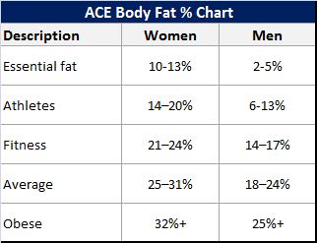
Percent Body Fat
*The ratio of body fat compared to all other tissue (muscle, organs, bones, blood and other fluids)

Slide 12
Percent Body fat charts

Slide 13
Waist to hip ratio
A measurement of obesity that compares waist size to hip size
To determine the amount of visceral fat which resides in the abdominal area and linked to lifestyle diseases; such as, coronary heart disease, hypertension and type 2 diabetes
Abdominal obesity:
Men = 0.90
Women = 0.85

Slide 14
http://nutritionfirstfitness.com/tools.php?tool=waisttohip

